Slide 1
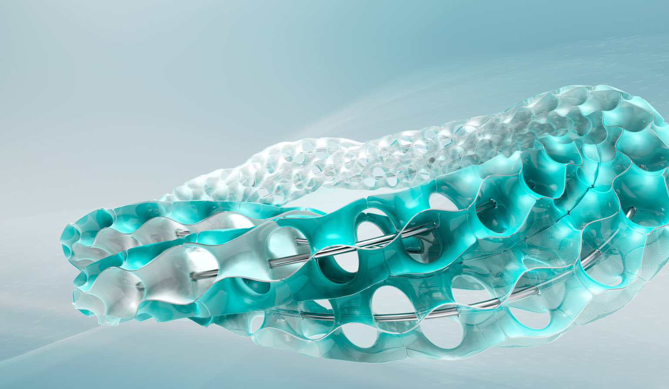


Admin Training
Site Administration

Slide 2
Learning Objectives Site Administration
Teach
(Slides)
Show
(Demo)
Do
(Exercises)
Review
(Q&A)
Workspace Administration Overview
Managing User Security
Users
Groups
Roles & Permissions
Building Sections, Fields, and Tabs
Building a Workflow
Site Setup
Administrative Tracking

Slide 3
1 – Workspace Administration Overview

Slide 4




Workspaces
Workspaces are the building blocks or modules of Fusion Lifecycle in which to store, view, and work with data. They can be configured to suit specific business needs. Workspaces are controlled by permissions.
Sample Workspaces
Items & BOM’s
Change Requests
Change Orders
Project Management
New Product Introduction
Inspections
Non Conformance
Tenant
Supplier
Quality
Workspaces
Engineering
Change Management

Slide 5
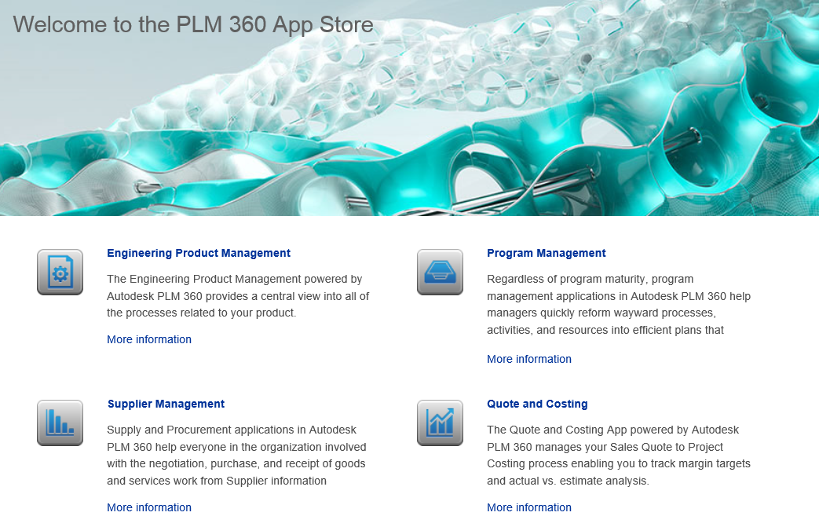
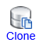
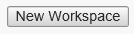
Creating a Workspace
1
Download from App Store
2
Clone a Workspace
3
Create a new Workspace

Slide 6
App Store
Autodesk Fusion Lifecycle Apps are collections of workspaces that work together to perform business functions. The apps get you up and running quickly with best-practice processes that are ready to use as delivered or that you can fully configure to meet your exact needs.
Sample Apps:
Engineering Product Management
Program Management
Supplier Management
Quality Management
Engineering Change Management
New Product Introduction (NPI)
Document Control
Field Service Report

Slide 7
Workspace Types
1 Basic Workspace
Manage data without workflow.
2 Basic Workspace with Workflow
Manage data with workflow.
3 Revision-Controlled Workspace
Manage the lifecycle of products or parts, where items have lifecycle phases and revisions.
4 Revisioning Workspace
Use this type of workspace to control items in a Revision-Controlled Workspace.
5 Supplier Management
Manage suppliers for Sourcing and Costing.
6 Supplier Management with Workflow
Manage suppliers for Sourcing and Costing with workflow capabilities.

Slide 8
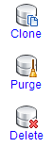
Managing a Workspace
Clone: Creates a new empty workspace based on source setup without Roles, Workflows or Scripts
Purge: Removes Data from current workspace without touching the setup
Delete: Removes both Setup and the Data, without an option to undo.

Slide 9



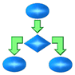



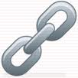
Relationships
Fusion Lifecycle’s Workspace and Relationship solution allows users to map between many workspaces simultaneously.
Relationship Types:
Bill of Materials: Hierarchical relationship between items of the same workspace or any other workspace
Relationships Tab: Uni/Bi-directional item-to-item relationships
Workflow Items Tab: Groups of items for many workspaces to promote through user defined lifecycle processes
Project Management Tab: Linking items from many workspaces into the Project Management Tab
Workspace A
Workspace B
Workspace C
CUSTOMER
TENANT

Slide 10
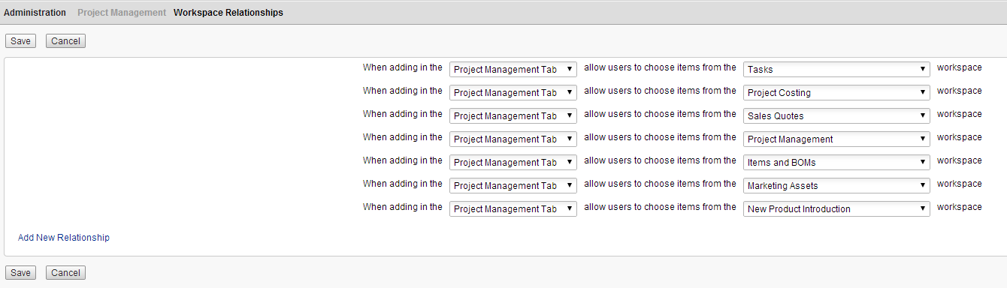
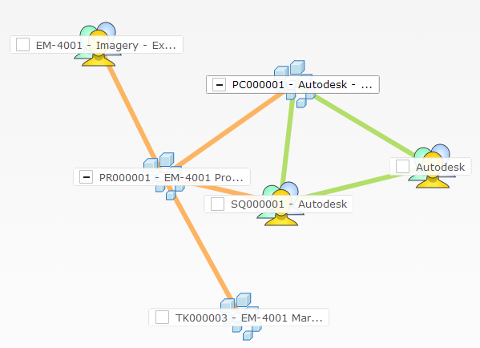
Workspace Relationships
Linking Workspaces
Visualize Tool

Slide 11
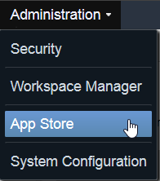
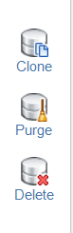
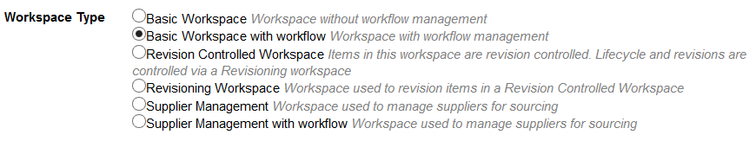
Teach
(Slides)
Show
(Demo)
Do
(Exercises)
Review
(Q&A)
Demo Topics Workspace Administration Overview
Downloading a Workspace
Browse App Store
Clone a Workspace
Cloning a Workspace
Purge vs. Delete
Create a Workspace
Types of Workspaces
Notes:
Create a Workspace of Type Basic with Workflow (Personnel Request - Instructor)

Slide 12
2 – Managing User Security

Slide 13
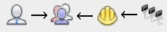
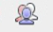
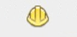
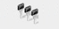
Groups
Users
Roles
Permissions
An individual person with an account for signing into Fusion Lifecycle.
A set of users that contains various roles, usually mirroring the function they perform in the system.
A collection of permissions that allow access to a specific workspace.
An action that a user may perform such as viewing, adding, editing or deleting data. Includes visibility to tabs on the item.
Group:
Change Management - Editors
Role:
Items and BOMs [R/W]
Permissions:
Add, View, Edit
Workspace:
Items and BOMs

Slide 14
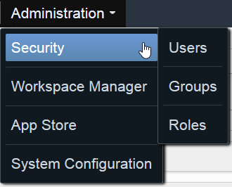
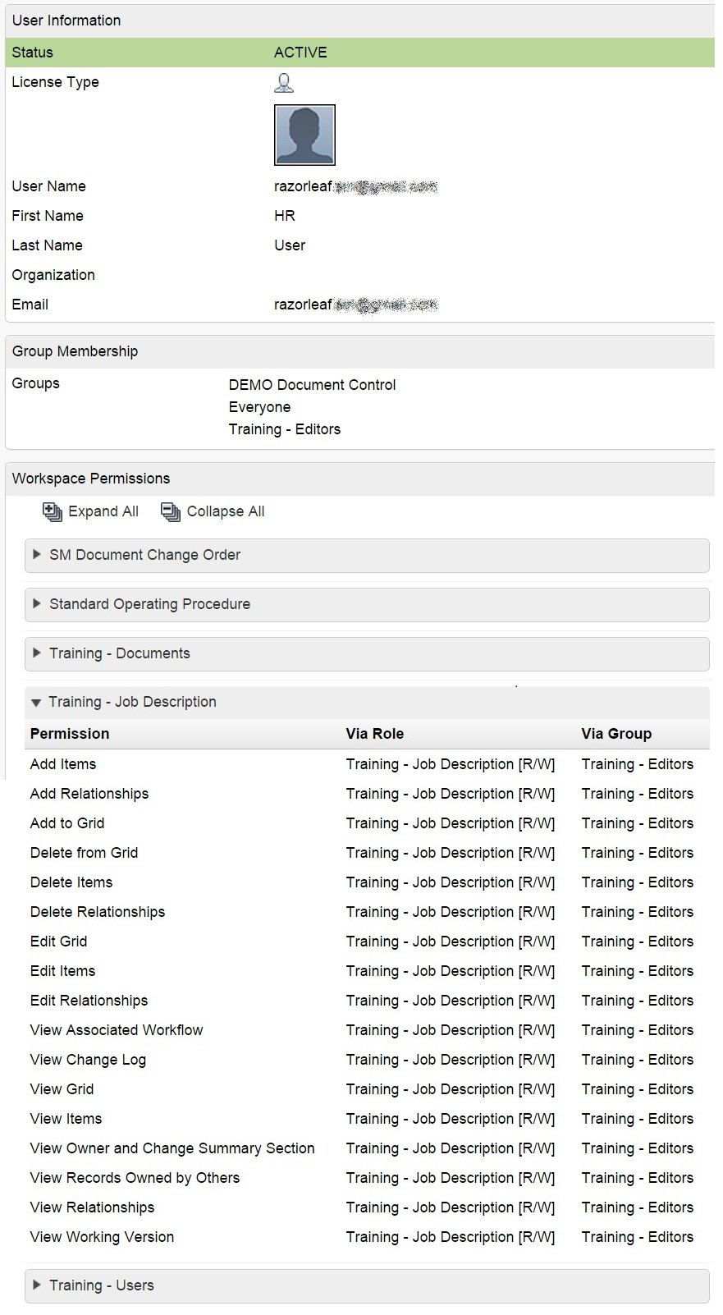
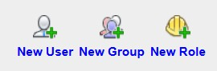
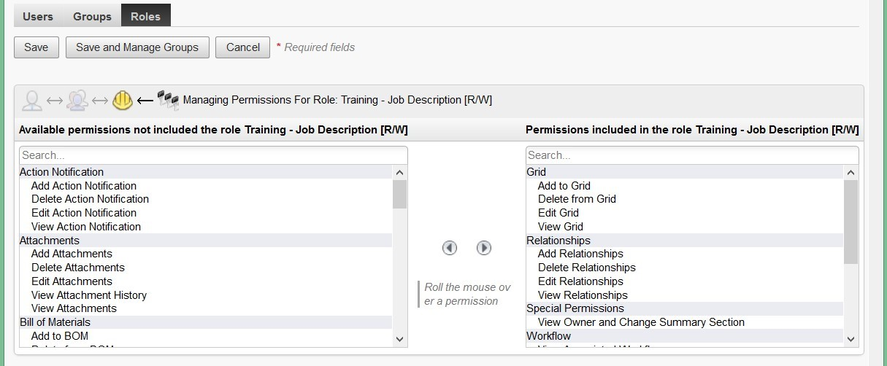
Teach
(Slides)
Show
(Demo)
Do
(Exercises)
Review
(Q&A)
Demo Topics Managing User Security
Roles & Permissions
Creating new roles
Assigning permissions
Assigning role to group
Users & Groups
Creating users
Creating groups
Assigning users to groups
View all permissions that a user has in each workspace
For more info:
https://razorleaf.com/2015/08/understanding-users-groups-roles-and-permissions-in-autodesk-plm-360/
https://razorleaf.com/2015/10/best-practices-for-user-security-in-plm-360/

Slide 15
Exercises 1 - 2
Teach
(Slides)
Show
(Demo)
Do
(Exercises)
Review
(Q&A)

Slide 16
3 – Building Sections, Fields, and Tabs

Slide 17

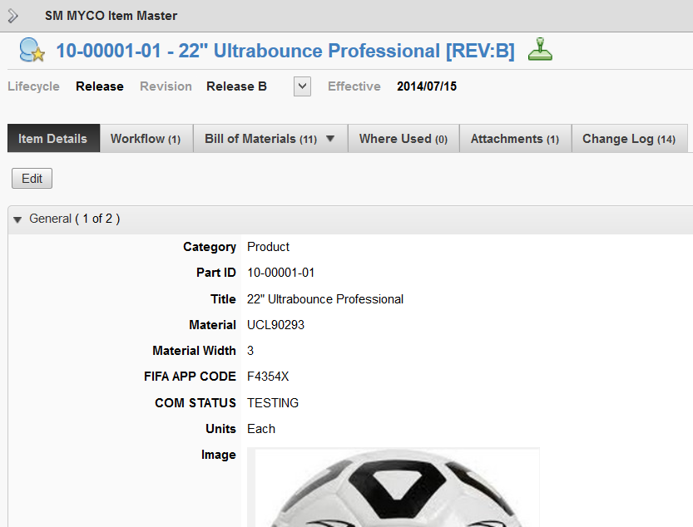
End Result
Workspace
Tabs
Section
Fields

Slide 18
Sections
Sections act as a container for fields that are within an item. Sections can be configured with separate permissions, and are collapsible.
Part 1001: Soccer Ball
Item
Item Details
Section 1
Part ID
Part Name
Item Attributes
Section 2
Weight
Size

Slide 19
Fields
As we have seen, fields contain the detailed data and information within an item. Fields can be configured using a variety of field types.
Field Types
Text
Numeric
Date
Check Boxes
Image
URL
Email
CSV
Flash
BOM UOM Pick List
Derived
Pick List
Part 1001: Soccer Ball
Item
Part ID
Part Name
Fields
Weight
Notes

Slide 20
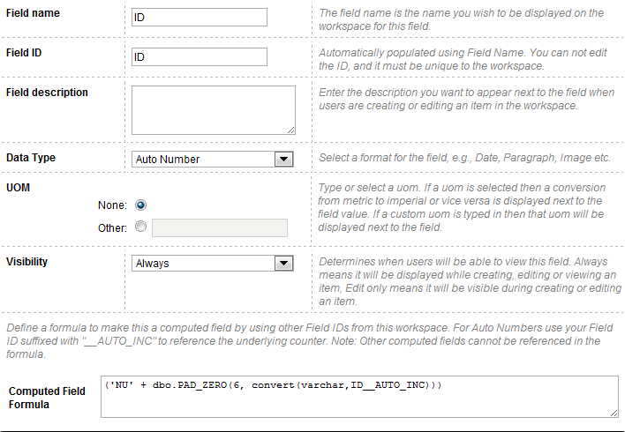
Special Field Types: Auto Number
Auto Number
Computed Field
Customizable String
Pre-Postfix Characters
Variable Length

Slide 21
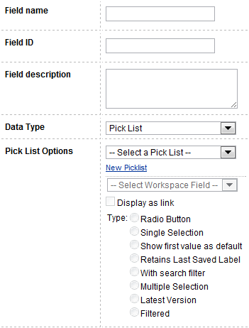
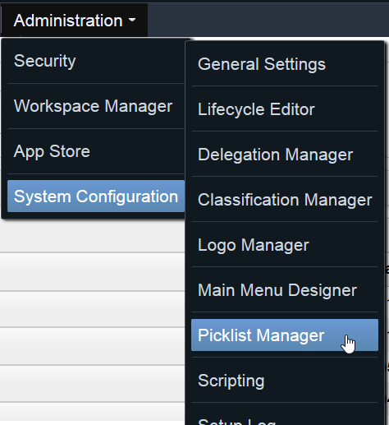
Special Field Types: Pick List
Pick lists are lists of values that can be set up on a site level and used across multiple workspaces.

Slide 22
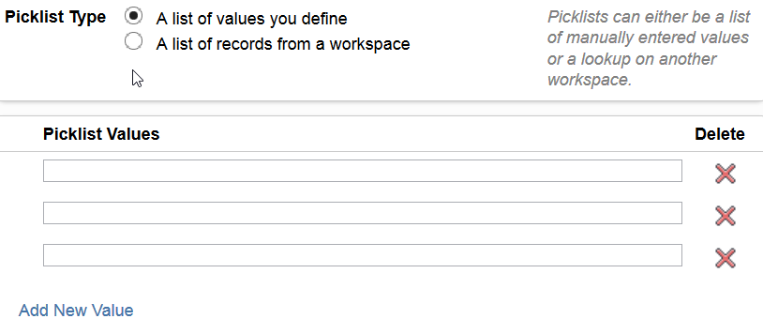
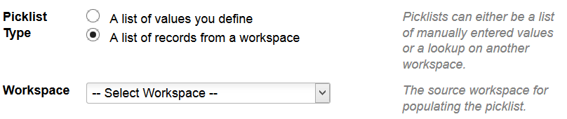
Special Field Types: Pick List
Two Types:
Defined Pick List
Workspace Pick List (Ex. target of a “Linking Pick List”)
Best Practices
Naming
Company abbreviation at the front of the defined pick list name Ex. RZLF_Custom Pick List Name
[WS] followed by the picklist name Ex. [WS] Change Request for a workspace pick list
Descriptions
Add company name as the description for all custom pick lists

Slide 23
Matrix
A Matrix acts as a table-type container for fields that are within a section. This allows information to be displayed in a pre-defined number of rows and columns on the Item Details tab. Each cell is a field.
Part 1001: Soccer Ball
Item
Item Details
Section 1
Part ID
Attribute
Matrix 1
1
2
3

Slide 24
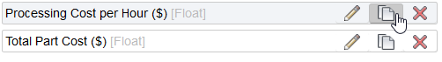
Cloning Fields
Reap time savings when you clone fields of the same type
...especially when building fields for a matrix

Slide 25
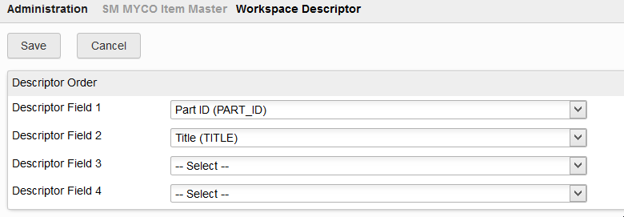
Item Descriptor
The item descriptor is created by specifying up to four fields to be concatenated and used to identify an item. An example is an item’s number or ID and short description or title.

Slide 26
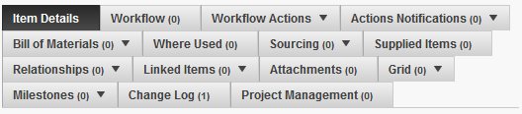
Tabs
Item Details
Workflow or Associated Workflow
Workflow Actions
Actions Notifications
Bill of Materials
Where Used
Sourcing
Supplied Items
Relationships
Linked Items or Affected Items
Attachments
Grid
Milestones
Change Log
Project Management

Slide 27
Tabs
Tabs are turned on or off via permissions in a workspace role
Tabs can be re-ordered and renamed
Certain fields can be configured on five of the tabs for greatly expanded flexibility in meeting business needs
Tips
Always include the permission of “View Change Log”
Put the tabs in the order in which a user would want to access them
For easiest re-ordering, shrink the browser window until the tabs are in two columns

Slide 28
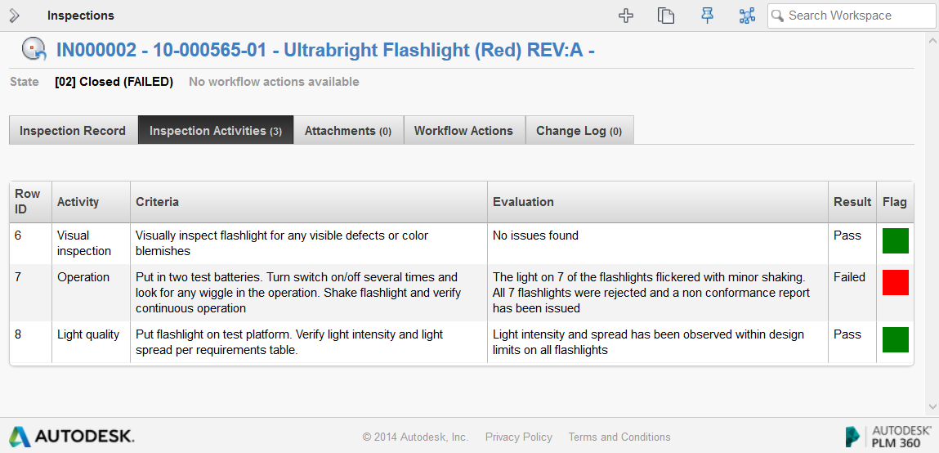
Grid Tab
Open-ended number of entries
Can be renamed

Slide 29

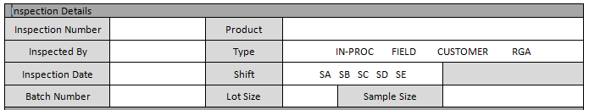
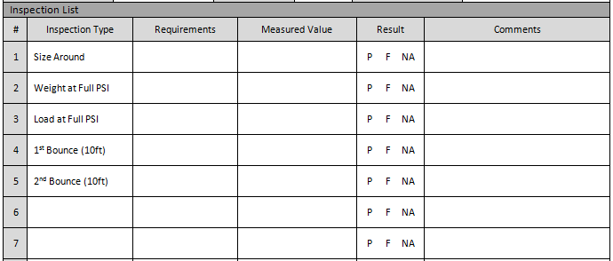
Building Workspace Elements
Heading
Workspace
Subheadings
Section
Main Section
Field Types
Table
Grid Tab
Signature
Workflow
Document #
System Controlled

Slide 30

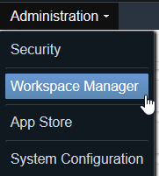
Building Workspace Elements
Your workhorse is the Workspace Manager!

Slide 31
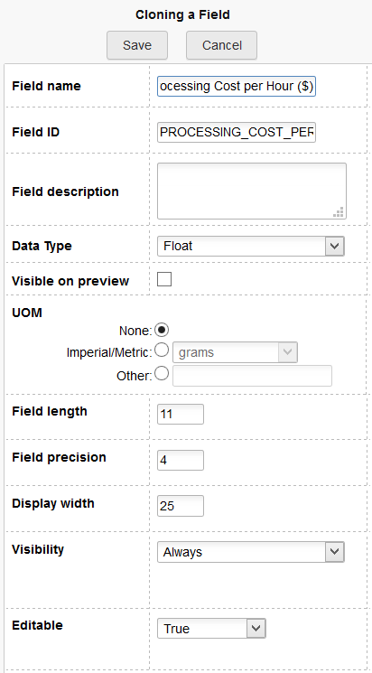
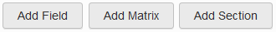
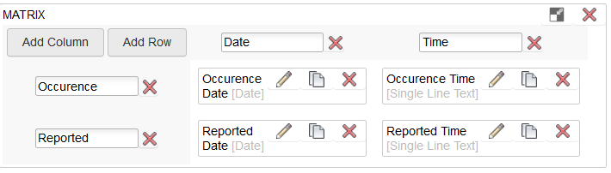
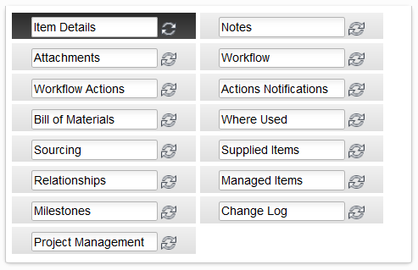
Teach
(Slides)
Show
(Demo)
Do
(Exercises)
Review
(Q&A)
Demo Topics Building Sections, Fields, and Tabs
Sections & Fields
Creating Sections
Adding Fields
Field Types
Matrix
Cloning Fields
Creating Picklists
Defining Descriptor
Tabs
Grid Tab
Renaming Tabs

Slide 32
Exercises 3 - 5
Teach
(Slides)
Show
(Demo)
Do
(Exercises)
Review
(Q&A)

Slide 33
4 – Building a Workflow

Slide 34
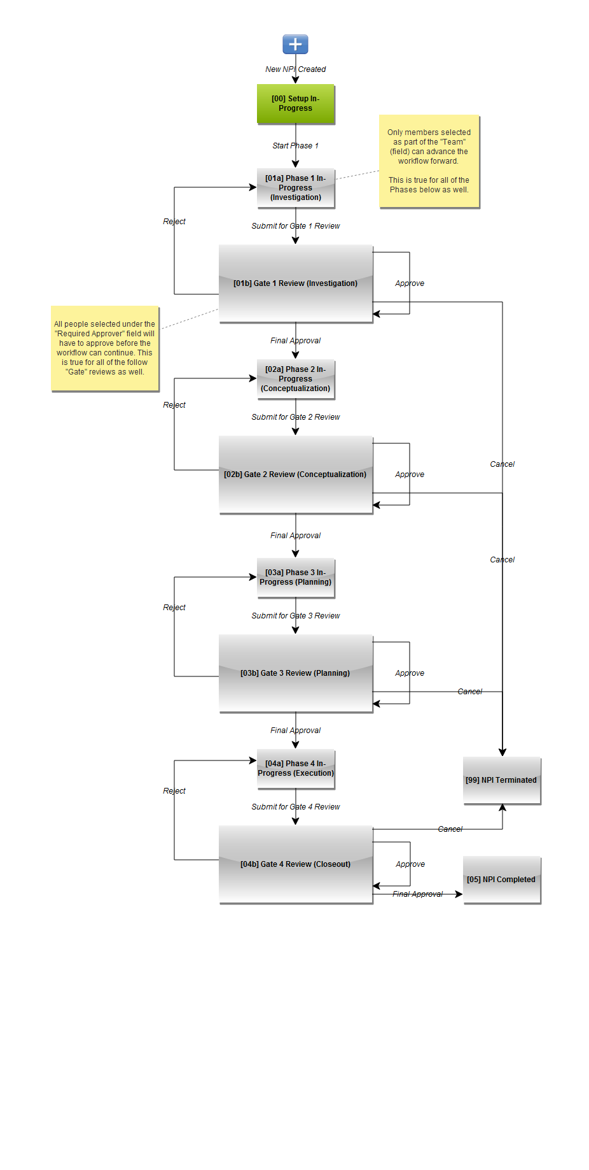
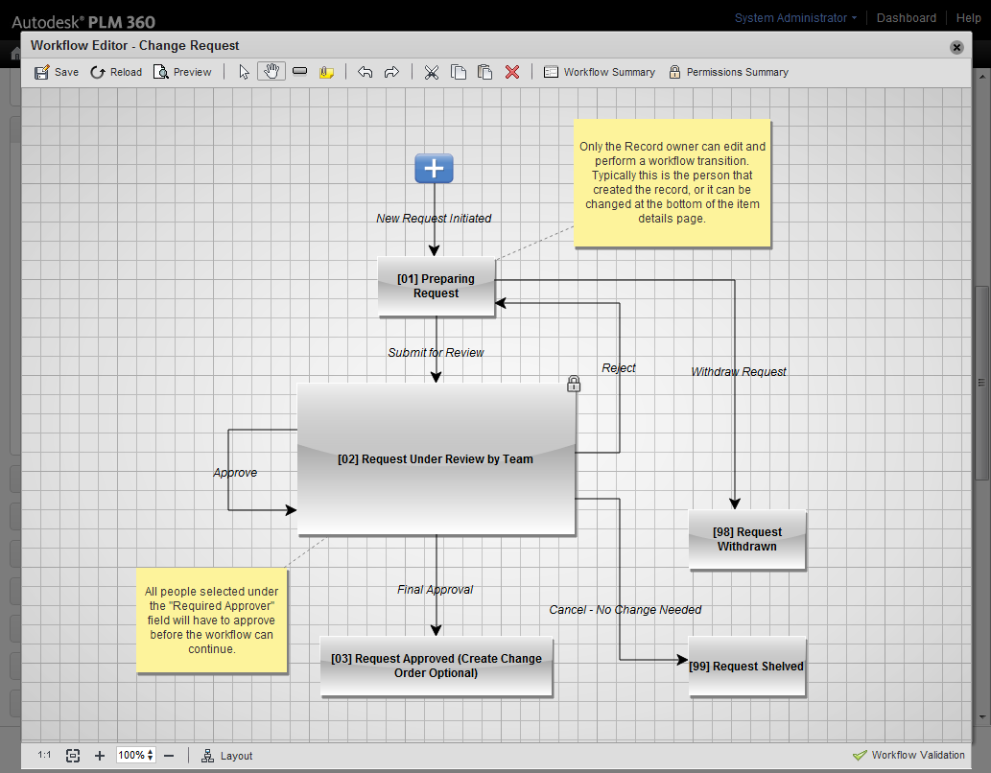
Workflow
Workflow refers to the process of moving an item through a pre-defined set of states. As people finish their tasks, they transition the item to the next state.
Workflow Tools include:
Permissions on who can do what when
Tracking (who signed off and when)
Item state access for filtering/reporting
Automated notifications on actions
Emails – on task assignment
In product Dashboard – my open tasks
Automated notifications on entering/leaving states
Automation (via the scripting engine)
To be continued...

Slide 35
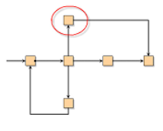
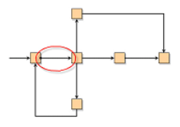
Workflow States & Transitions
Workflow State: A state is a point within a workflow. All items in a Workspace with Workflow are in a specific state at any given time.
Workflow Transition: A transition is a path from one workflow state to another.
Tips
Use numbers to begin the state name (so milestones & reports can be in process order!)
Add transitions with the naming convention “Submit to [next state]” Ex. Submit to Approve
Give each transition a unique name so that reporting provides clarity

Slide 36
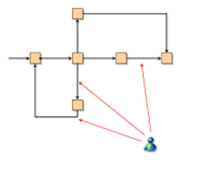
Workflow Permission
Workflow Permission: Every transition in a workflow has a workflow permission associated with it. To perform that transition, a user must have the permission associated with it.

Slide 37
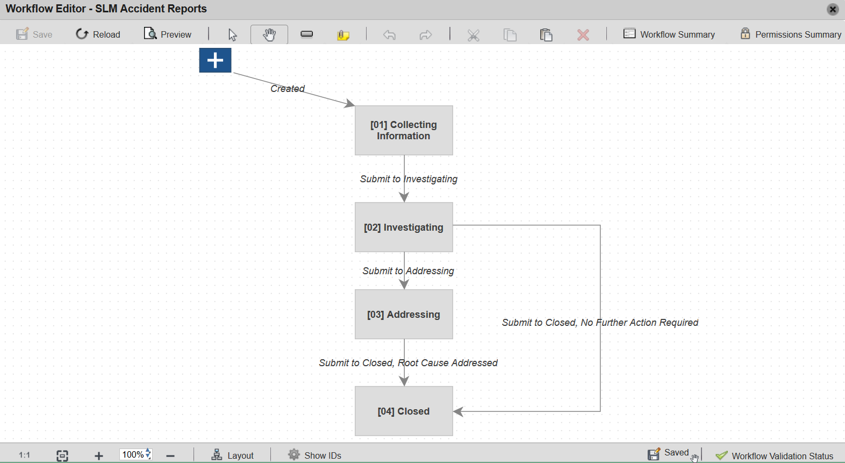
Workflow Editor

Slide 38
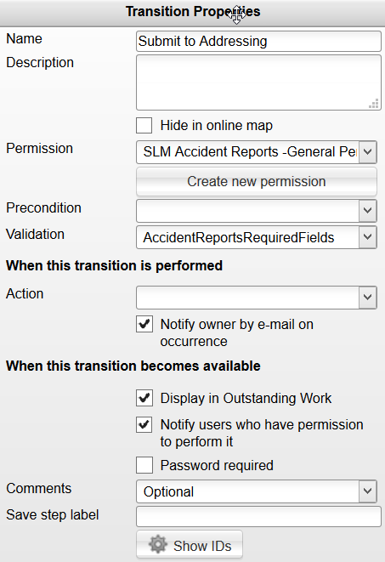
Transition Properties
Transition can be hidden
Workflow Permission (custom)
Possible Script Invocation Locations
Checkboxes to Configure Notifications and My Outstanding Work
Password can be required or not
Comments can be optional, required, or disabled

Slide 39
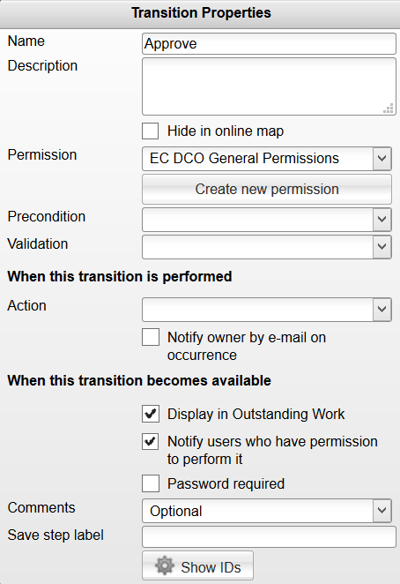
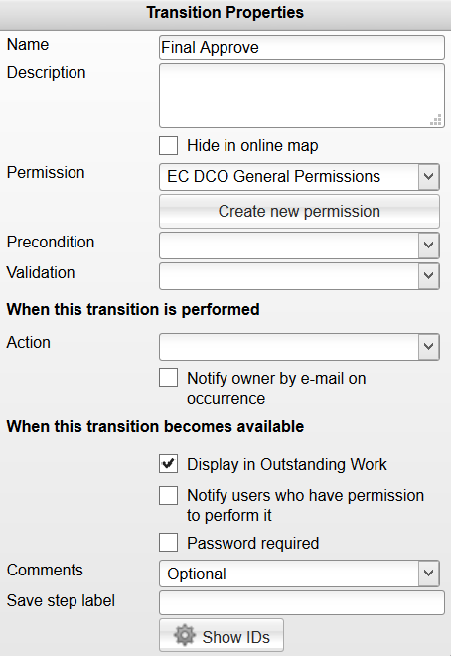
Workflow Notifications
Checkbox in Transition Properties Flyout
“Approve” transition needs notify users box checked
“Final Approve” transition must NOT have notify users box checked to avoid duplicate notifications

Slide 40
Workflow Permissions
Workflow permissions will appear after you save a WF map
These permissions grant whether or not a person can respond to a WF
Start off simple with a global permission
Add additional permissions as needed based on who should be allowed to do a particular action
Override Lock: allows you to edit a record even if it's locked by WF
Undo Step: rolls back workflow and permanently deletes the history of that step

Slide 41
Dedicated Workflow Permission Role
Workflow permissions play a critical role in why a user can or cannot perform certain actions. For example, a user without the correct workflow permissions cannot add rows to a grid, attachments, or obviously promote an item. It is much easier to troubleshoot such issues when each WF permission is assigned to its own role, and then that role is assigned to the appropriate groups.
Tips
Assign each Workflow Permission to its own Role so it can be easily assigned and managed
Use the square bracket naming convention for the role, Ex. Accident Reports [General – WF]

Slide 42
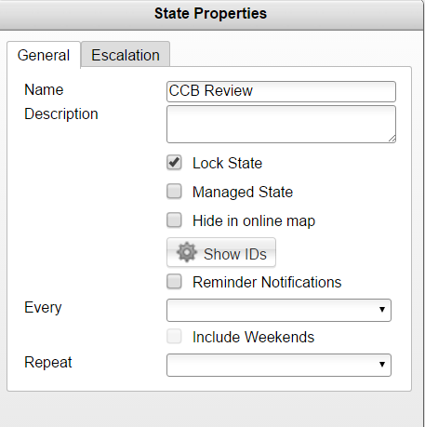
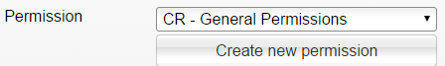
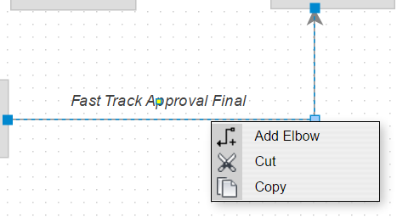
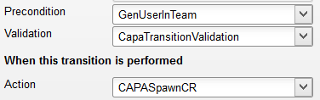
Teach
(Slides)
Show
(Demo)
Do
(Exercises)
Review
(Q&A)
Demo Topics Building a Workflow
Workflow Editor
Workflow States
Transitions
Transition Properties
Workflow Permissions
Minimum Requirements for a Workflow
Viewing Name of Invoked Scripts
Notes:
Screenshot for Viewing Name of Invoked Scripts comes from base app, CAPA, “Close” transition

Slide 43
Exercises 6 - 10
Teach
(Slides)
Show
(Demo)
Do
(Exercises)
Review
(Q&A)

Slide 44
5 – Site Setup

Slide 45

Main Menu Designer
With Main Menu Designer, you can organize Workspaces and Menu Categories (Apps) on the Main Menu.
Tips
Zoom the browser in as needed to speed dragging workspaces to their destination category

Slide 46
General Settings
Access General Settings to choose tenant-wide settings.
Descriptor formatting
Email Settings
Support Settings
Security for Concurrent Sessions
Display
Revision Control
BOM Settings
Tips
The default settings are most often kept

Slide 47

Logo Manager
Brand your tenant with your company logo!

Slide 48

Unit of Measure Manager
Specify what units of measure are available to choose from in your tenant. These UOMs will then appear on bills of materials.

Slide 49



Teach
(Slides)
Show
(Demo)
Do
(Exercises)
Review
(Q&A)
Demo Topics Site Setup (System Configuration)
Main Menu Designer
General Settings
Logo Manager
UOM Manager

Slide 50
Exercise 11
Teach
(Slides)
Show
(Demo)
Do
(Exercises)
Review
(Q&A)

Slide 51
6 – Administrative Tracking

Slide 52


Administrative Tracking
Change Log
Added via Workspace Permissions
Accessed from each item
Setup Log
Accessed from the Administration menu
Displays all Setup-related actions in a tenant
Script Modified, Workspace Created, New User, Etc.
System Log
Accessed from the Administration menu
Displays all System-related actions in a tenant
Item Created or Modified, Login, Profile Modification, Etc.

Slide 53



Teach
(Slides)
Show
(Demo)
Do
(Exercises)
Review
(Q&A)
Demo Topics Administrative Tracking
Change Log
Setup Log
System Log

Slide 54
Exercises 12 - 13
Teach
(Slides)
Show
(Demo)
Do
(Exercises)
Review
(Q&A)

Slide 55
Review Site Administration
Teach
(Slides)
Show
(Demo)
Do
(Exercises)
Review
(Q&A)
Workspace Administration Overview
Managing User Security
Users
Groups
Permissions & Roles
Building Sections, Fields, and Tabs
Building a Workflow
Site Setup
Administrative Tracking

